Slide 1
Multilevel Cybersecurity System
Assoc. Prof. David Gulua, NDA

Slide 2
Cybersecurity is complex
Protecting personal PCs and mobile devices, fighting malware, Encrypting data and verifying it’s integrity - ok for ordinary users
Cybersecurity experts (ITSOs) are responsible for security of entire IT-Infrastructure

Slide 3
IT-Infrastructure = Surrounded Fortress
Numerous threats
Hackers
Malware
Insiders
Potential source of threats – Entire Internet

Slide 4
Multilevel (Echeloned) Defense
At least 2, better 3-4 security levels
A large variety of security hardware and / or software
Integrated security systems

Slide 5
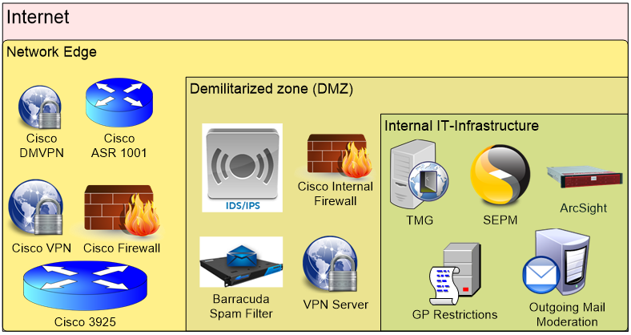
Multilevel Cybersecurity - Example

Slide 6
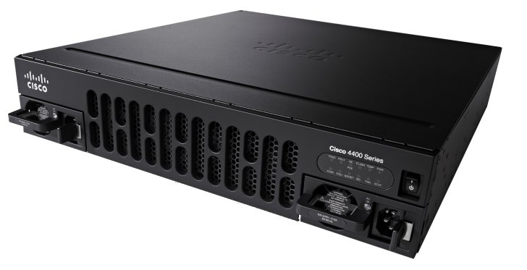
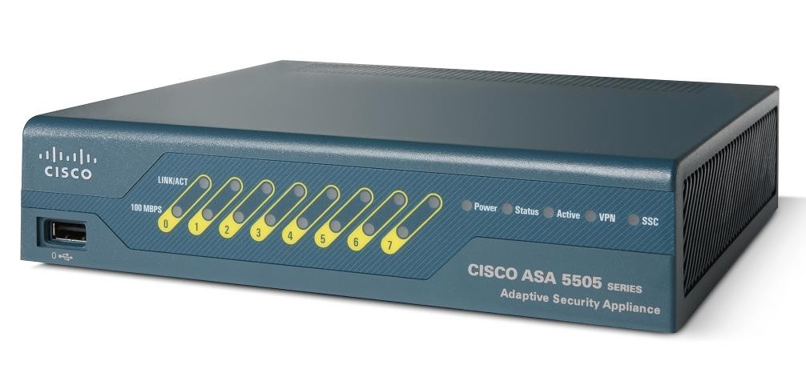
Network Edge
Security devices
Gateway router
External Firewall
Access rules
VPNs for secure access from outside
Gateway router
Firewall

Slide 7
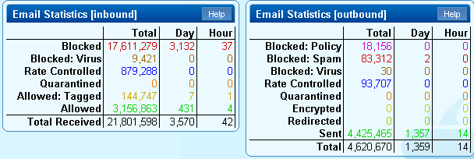
Demilitarized zone (DMZ)
Web- and FTP-sites, Mail-server etc.
Internal firewall
Proxy-service
IDS/IPS
Spam filtering (Spam firewall)
Application firewall
Etc…
Spam firewall

Slide 8
Internal IT-Security
Proxy service
Domain and Group policies
Central antivirus- and antimalware software
Encryption
Monitoring and logging
DLP (Hardware/Software, moderation of outgoing e-mails)
…
Squid proxy server logo

Slide 9
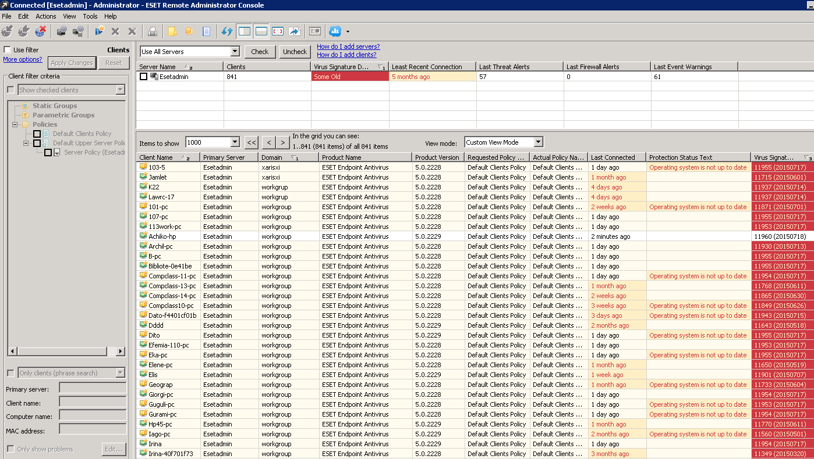
Central Antivirus and Antimalware

Slide 10
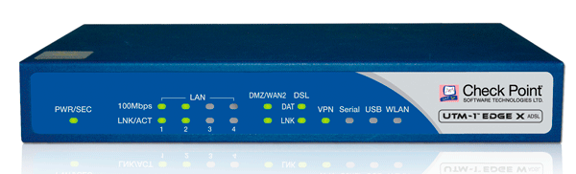
Need more security?
Integrated security appliances and/or software (UTM-devices aka NG Firewalls)
High performance due to special equipment (ASICs)
High costs
CheckPoint NG Firewall

Slide 11
Is there full security now? No!
let's go back to the beginning…
Never ignore local security on local network equipment, employees PCs and mobile devices
Always purchase licensed software, no untrusted sources, no cracks
Keep your OSs and desktop software always up-to dated
Train your staff and get trained…

Slide 12
What next?
Virtual lab based on Windows Server 2012
Active directory and group policies covering security issues
Password policy
Block applications
Proxy-service (CC Proxy)

Slide 13
Questions?

